Slide 1




Cecile Foerster
Demographic Study
KIMA ELMORE EDSP 6315 FALL 2015 DR. REED

Slide 2
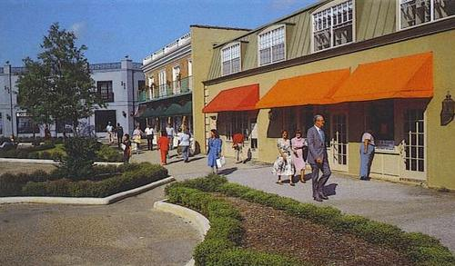
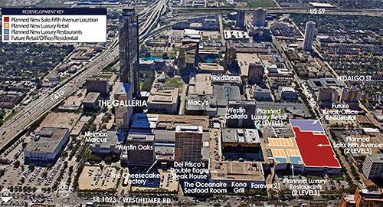
Historical Background:
Cecile Foerster Elementary School was initially developed in within the community of Westbury during the 1960s. The community flourished due to the establishment of a thriving shopping center known as the Westbury Square. Established prior to the Galleria, The Westbury Square was considered the premier shopping destination in the city. After the opening of the Galleria in 1971, Westbury Square began to decline. The opening of the Galleria caused tenants to move there from smaller shopping centers in suburban areas, such as Westbury Square.

Slide 3
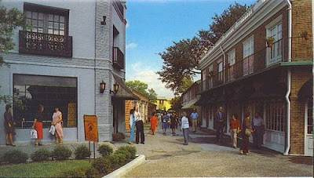
Historical Background:
Westbury is a neighborhood in the Brays Oaks district of Southwest Houston, Texas, United States. It is located east of Bob White Road, north of U.S. Highway 90 Alternate (South Main Street), and west of South Post Oak Road, adjacent to the Fondren Southwest and Meyerland neighborhoods, just west of the southwest corner of the 610 Loop.
Foerster Elementary is located in Southwest Houston, Texas within the community of Westbury. Westbury was developed in the 1950s and 1960s by Ira Berne as part of the post–World War II migration to the suburbs. The developer had moved from Westbury, New York, after which he named the new community.

Slide 4
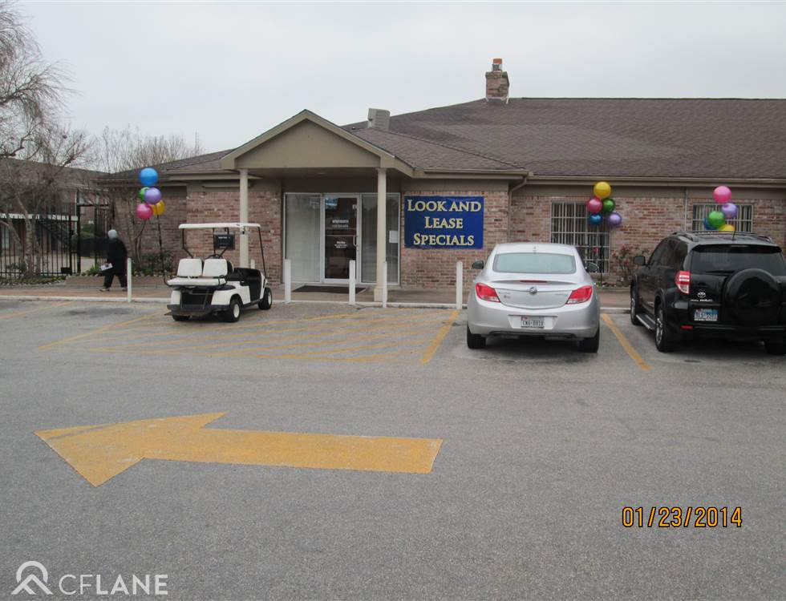
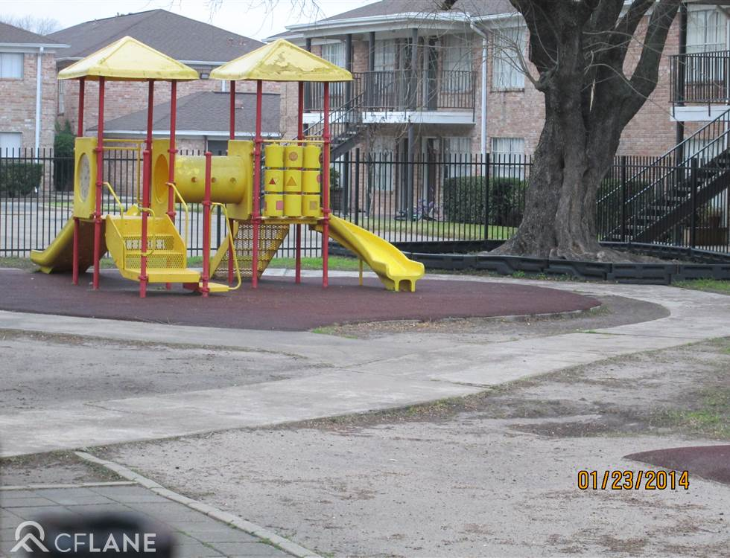
How was the area, community, or neighborhood developed?
In 1960 Berne had developed the Westbury Square, a shopping center located on a 7.5-acre (3.0 ha) site near the intersection of Chimney Rock Road and West Bellfort Avenue, in the Westbury neighborhood in the Brays Oaks district of Southwest Houston, Texas.
The current population of Foerster Elementary primarily includes residents of Pines of Westbury, Los Arcos, and Greenhouse Patio Apartments, and surrounding apartments.

Slide 5
LETS TAKE A TOUR AROUND THE NEIGHBORHOOD
https://www.google.com/maps/@29.6386313,-95.4984795,3a,75y,337.65h,75.35t/data=!3m6!1e1!3m4!1sGO9i6aOhk2_jhf5rDnpLrg!2e0!7i13312!8i6656!6m1!1e1

Slide 6
Who were some of the individuals recognized as pioneers of the community?
Ira Berne (Westbury Square Developer)
Gerry Berne (Westbury Square Developer)
William J. Wortham, Jr. (Architect)

Slide 7
Are there any important historical events related to the school to note?
In the 1980s the City of Houston Housing Authority proposed a 105-unit project in the Westbury area. Thousands of residents entered public hearings to protest the concept, so the city did not build any public housing in the Westbury area. The protesters lost their campaign, resulting in the construction of the current homes in which the school now services.

Slide 8

How many schools and facilities are contained in the district?
Foerster Elementary School is a Houston Independent School District (HISD) campus located in Southwest Houston, Texas. HISD services:
283 schools
10 early childhood
153 elementary
37 middle
40 high
43 combined/other

Slide 9
When was the campus opened?
Foerster Elementary has been occupied since August 1964 and opened its campus in 1967.

Slide 10
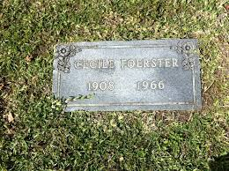
Why was the campus given its specific name?
Cecile Foerster was a highly respected teacher and administrator in Rosenberg and Houston for four decades. In addition, she was coauthor of the Working with Numbers mathematics workbooks. The campus that bears her name was established in 1967.

Slide 11
Campus Governance:
STUDENT, PARENTS, & COMMUNITY
TEACHERS
TEACHER SPECIALISTS
PRINCIPAL
TEACHER SPECIALISTS/ PRINCIPAL
SIO/ SUPERINTENDENT

Slide 12
What is the chain of command in the school?
Principal
Dean of Instruction
Counselor
Math Interventionalist
Reading Interventionalist
Teacher Specialist

Slide 13
How is the campus site-based committee selected and how does it function?
• SDMC: A heterogeneous group of campus that meet to discuss and plan executive functions and policies of the campus
• Grade Level Chairs: Relay vital information from principal to member of each grade level
• 212 Committee: Student and Faculty Climate/Morale Booster Team

Slide 14
What is the district enrollment? (Disaggregate by ethnicity, socio-economics, grade level etc.)

Slide 15
What is the school enrollment? (Disaggregate by ethnicity, socio-economics, grade level etc.)
Images provided by www.houstonisd.org/cms/lib2/TX01001591/.../Foerster_ES.pdf

Slide 16
What are the strong and weak areas of student performance on the state exams?
STRENGTHS
Fifth Grade Math (80%)
Fifth Grade Reading (63%)
WEAKNESS
Fourth Grade Reading (29%)
Fourth Grade Math (42%)
Images provided by www.houstonisd.org/cms/lib2/TX01001591/.../Foerster_ES.pdf

Slide 17

What are the socio-economic levels of the families?
Foerster Elementary serves a diverse student population with over 99% of our students receiving Free /Reduced Lunch. Special programs include Pre-K (Head Start), ESL, Bilingual, and Title I.

Slide 18

How active are families in various school activities?
Parents are mandated to register online through VIPS and pass a criminal background check before they can participate as a volunteer. Are HISD volunteers. The level of active families in various school activities on campus is fairly undersized in accordance to the student population. Programs such as Head Start and English Language courses provide opportunities for parent involvement. At Foerster there are parents and community volunteers that read to students, serve as classroom assistants to teachers, provide enrichment and hands-on experience with computers, work in the library, office, cafeteria, and provide other support.

Slide 19
How is the PTO/PTA organized?
There is no PTO/PTA established on campus.

Slide 20
Are there any significant geographical characteristics that might impact students or families?
Images provided by www.houstonisd.org/cms/lib2/TX01001591/.../Foerster_ES.pdf

Slide 21
What are the levels of education, years of experience, and demographic characteristics of professional staff at the district level?
Images provided by www.houstonisd.org/cms/lib2/TX01001591/.../Foerster_ES.pdf
Images provided by http://ritter.tea.state.tx.us/perfreport/tapr/2014/srch.html?srch=D

Slide 22
What are the levels of education, years of experience, and demographic characteristics of professional staff at the campus level? How do these groups compare?
Images provided by www.houstonisd.org/cms/lib2/TX01001591/.../Foerster_ES.pdf

Slide 23
Discuss potential areas for improvement.
• Parental Involvement
• Community Outreach programs
• Student Tutorials/Pullouts
Identify key stakeholders in the school and community.
• Students
• Parents
• Teachers
• Campus Administration
• Community Officials
• Community

Slide 24

Discuss leadership strategies you might use.
Parent Involvement:
Be sure the first contact with parents is a positive one.
Communicate with parents straightforwardly and simply.
Ensure that all parents have regular access to clear, concise, and easily readable information about their children's school and classroom.
Ask parents to share their concerns and opinions about school, and then address those concerns. Accommodate parents' work schedules.
Accommodate language and cultural differences
Provide staff development, technical assistance, consultation, and support

Slide 25
Discuss leadership strategies you might use.
Community Outreach:
Establish regular, meaningful communication between home and school.
Promote and support parenting skills.
Encourage active parent participation in student learning.
Welcome parents as volunteer partners in schools.
Invite parents to act as full partners in making school decisions that affect children and families.
Reach out to the community for resources to strengthen schools.
Provide staff development, technical assistance, consultation, and support

Slide 26
Discuss leadership strategies you might use.
Student Tutorials/ Pullouts:
provides teachers with explicit instruction training
provides students with explicit instruction
incorporates problem solving/ reasoning skills
provide communication in both oral and written formats
work at each student’s own pace with one-to-one student instruction
facilitate instruction by offering individual and small-group instruction as needed
In-depth, sequential skill building of foundational content
Fills critical grade-level learning gaps with a balanced, systematic approach

Slide 27




